Slide 1
CHAPTER 3: Basic Language Constructs of VHDL

Slide 2
Syllabus
Week | Content | Notes
1 | Chapter 0: Course Introduction (1) Chapter 1: Introduction to Digital Design (2)
2 | Chapter 2: Overview of HDL (3)
3 | Chapter 3: Basic Language Constructs of VHDL (3)
5, 6 | Chapter 4: Signal Assignment Statements of VHDL (6)
6 | Chapter 5: Combinational Logic Circuit Design (3)
7 | Midterm Exam (2)
8 | Chapter 6: Sequential Logic Circuit Design (3)
9, 10 | Chapter 7: Finite State Machine (FSM) Principle (6)

Slide 3
Content
Introduction
Basic VHDL Program
Lexical Elements and Program Format
Objects
Data Types and Operators

Slide 4
1. Introduction
To use a programming language, we first have to learn its syntax and language constructs.
VHDL is a complex language.
It is designed to describe both the structural and behavioral views of a digital system at various levels of abstraction.
Many of the language constructs are intended for modeling and for abstract, behavioral description.
Only a small portion of VHDL can be synthesized and realized physically in hardware.

Slide 5
2. Basic VHDL Program
A VHDL program is composed of a collection of design units
A synthesizable VHDL program needs at least two design units: an entity declaration and an architecture body associated with the entity.
The basis of a typical VHDL program can best explained by an example.

Slide 6
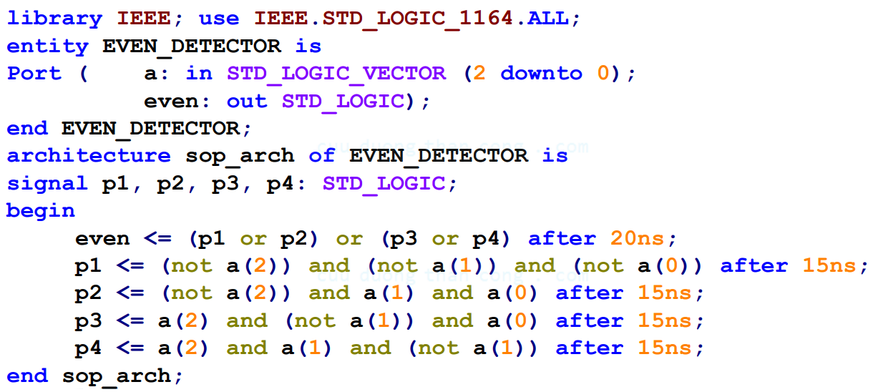
2. Basic VHDL Program

Slide 7
2. Basic VHDL Program
A VHDL program is composed of a collection of design units
A synthesizable VHDL program needs at least two design units: an entity declaration and an architecture body associated with the entity.
The basis of a typical VHDL program can best explained by an example.

Slide 8
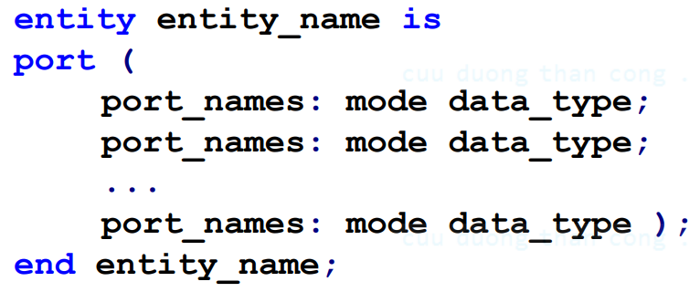
2. Basic VHDL Program
The simplified syntax of an entity declaration is
Mode: specifies how data is transferred through that port.
  In: The port is an input to the entity. You can read but cannot modify it.
  Out: The port is an output from entity. You can modify but cannot read it.
  Inout: The port is bidirectional. You can both read and assign a value to it.
  Buffer: used in older version of VHDL.

Slide 9
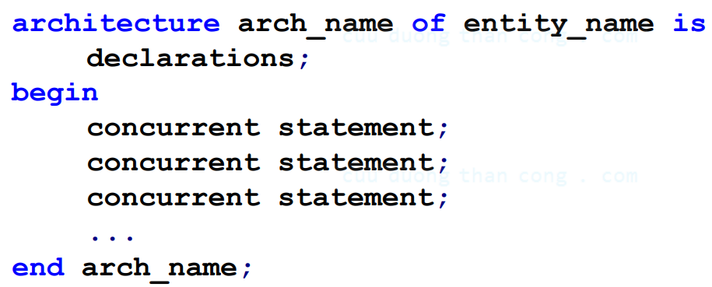
2. A Basic Constructs of VHDL
The architecture body specifies the internal operation of organization of a circuit

Slide 10
2. Basic VHDL Program
Design units are the fundamental building blocks in a VHDL program
When a program is process, it is broken into individual design units and each unit is analyzed and stored independently.
There are five kinds of design units:
  Entity declaration
  Architecture body
  Package declaration
  Package body
  Configuration

Slide 11
2. Basic VHDL Program
A package of VHDL normally contains a collection of commonly used items, such as data types, subprograms and components, which are needed by many VHDL programs.
In VHDL, multiple architecture bodies can be associated with an entity declaration.
A configuration specifies which architecture body is to be bound with the entity declaration.

Slide 12
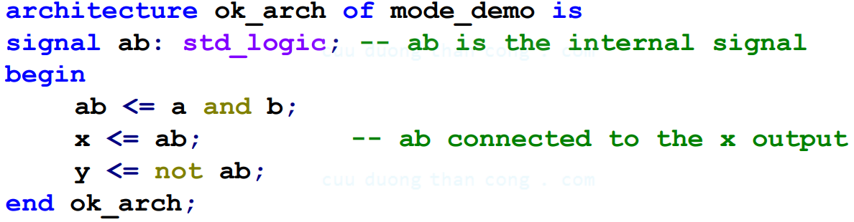
3. Lexical Elements and Program Format
A comment starts with two dashes, --, followed by the comment text
Anything after the – symbol in the line will be ignored. The comment is for document purposes only and has no effect on the code
For example, we have added comments to the VHDL code

Slide 13
3. Lexical Elements and Program Format
An identifier is the name of an object in VHDL
The basic rules to form an identifier are:
  The identifier can contain only alphabet letters, decimal digits and underscores.
  The first character must be a letter.
  The last character cannot be an underscore.
  Two successive underscores are not allowed.

Slide 14
3. Lexical Elements and Program Format
For example, the following identifiers are valid:
  A9, next_state, Next_State, mem_addr_enable, reset_n
On the other hand, the following identifies violate one of the rules and will cause a syntax error:
  Sig#3, -X10, 7segment_led, A10_, hi__there
Since VHDL is not case sensitive, the following identifies are the same
  Nextstate, NextState, NEXTSTAT, nEXTsTATE.

Slide 15
3. Lexical Elements and Program Format
To represent a number in VHDL, you can use the “base#number#” syntax, where “base” is the base of the number.
Base:
  2: binary
  8: octal
  10: decimal
  16: hex
For example, 45 can be represented as 2#101101# and 16#2D# in base 2 and base 16 respectively.
We can also add an underscore to enhance readability.
For example, 12_3456 is the same as 123456, and 2#0011_1010_1101# is the same as 2#001110101101#.

Slide 16
4. Objects (Signals)
The signal is most common object and we already used it in previous examples.
A signal has to be declared in the architecture body’s declaration section.
The simplified syntax of signal declaration is

Slide 17
4. Objects (Signals)
For example, the following line declares the a, b, and c signals with the std_logic data type.
According to the VHDL definition, we can specify an optional initial value in the signal declaration. For example, we can assign an initial value of ‘0’ to the previous signals:

Slide 18
4. Objects (Variables)
A variable is a concept found in a traditional programming language. It can be thought of as a “symbolic memory location” where a value can be stored and modified.
There is no direct mapping between a variable and a hardware part.
A variable can only be declared and used in a process and is local that process.
The main application of a variable is to describe the abstract behavior of a system.

Slide 19

4. Objects (Variables)
The syntax of a variable declaration is similar to that signal declaration.
The simplified syntax of a variable assignment is

Slide 20
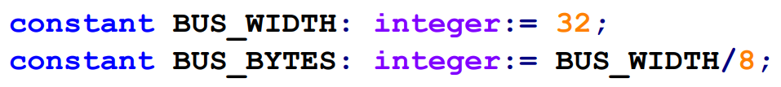
4. Objects (Constants)
A constant holds a value that cannot be changed. The syntax of constant declaration is
The value_expression term specifies the value of the constaint.
A simple example is:

Slide 21
5. Data Types and Operators
In VHDL, each object has a data type.
A data type is defined by
  A set of values that an object can assume.
  A set of operations that can be performed on objects of this data type
Predefined data types in VHDL:
  Integer: 32-bit range (from (-2^ 31) to (2^31 – 1))
  Boolean: defined as (false, true)
  Bit: defined as (‘0’, ‘1’)
  Bit_vector: defined as a one-dimensional array with elements of the bit data type.

Slide 22
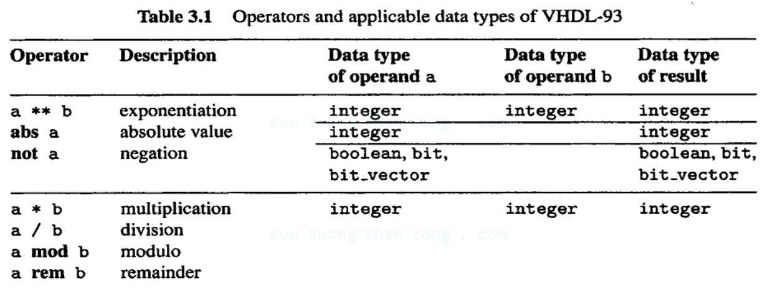
5. Data Types and Operators

Slide 23
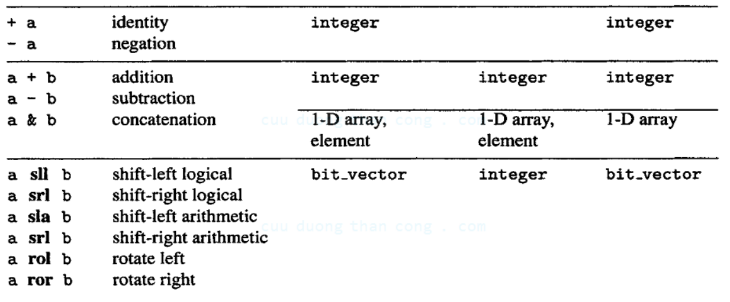
5. Data Types and Operators

Slide 24
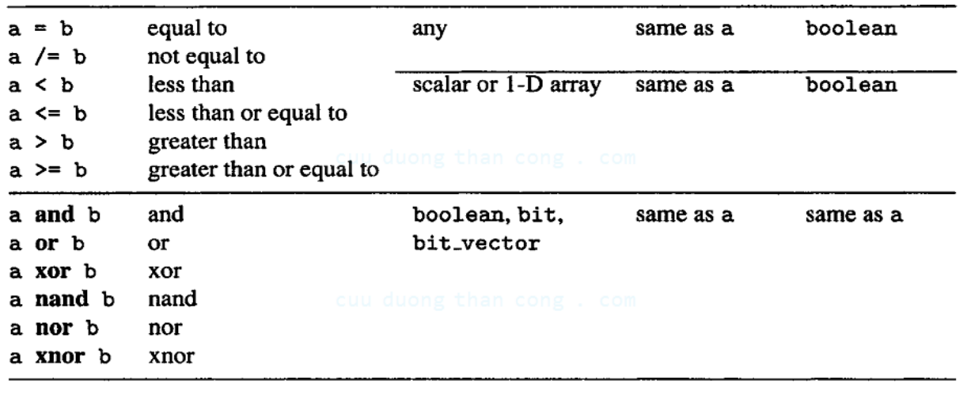
5. Data Types and Operators

Slide 25
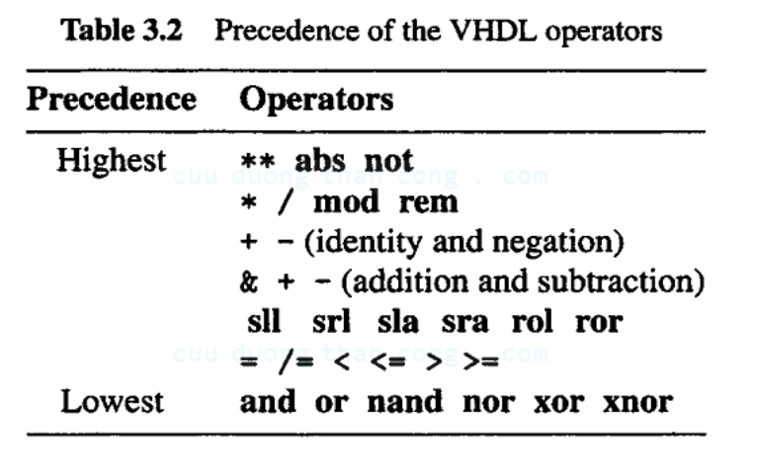
5. Data Types and Operators

Slide 26
5. Data Types and Operators
Data types in the IEEE STD_LOGIC_1164 Package
To better reflect the electrical property of digital hardware, several new data types were developed by IEEE to serve as an extension to the bit and bit_vector data types
These data types are defined in the std_logic_1164 package of IEEE standard 1164.
The std_logic data type consists of 9 possible values.
‘U’, ‘X’, ‘0’, ‘1’, ‘Z’, ‘W’, ‘L’, ‘H’, ‘-’

Slide 27
5. Data Types and Operators
‘0’ and ‘1’: stand for “forcing logic 0” and “forcing logic 1”, which mean that the signal is driven by a circuit with a regular driving current.
‘Z’: stands for high impedance, which is usually encountered in a tri-state buffer.
‘L’ and ‘H’: stand for “weak logic 0” and “weak logic 1”, which mean that the signal is obtained from wired-logic types of circuits, in which the driving current is weak.
‘U’: stands for uninitialized. It is used in simulation to indicate that a signal or variable has not yet been assigned a value.
‘-’: stands for don’t care.

Slide 28
5. Data Types and Operators
‘X’ and ‘W’: stand for “unknown” and “weak unknown”.
The unknown represents that a signal reaches an intermediate voltage that can be interpreted as neither logic 0 or logic 1. This may happen because of a conflict in output (such as a logc-0 and logic-1 signal being tied together). They are used in simulation for an erroneous condition.

Slide 29
5. Data Types and Operators
Among these values, only ‘0’, ‘1’ and ‘Z’ are used in synthesis.
The ‘L’ and ‘H’ values are seldom used now since current design practice rarely utilizes a wired-logic circuit.
The use of ‘X’ and the potential problem of ‘-’ are discussed later.

Slide 30
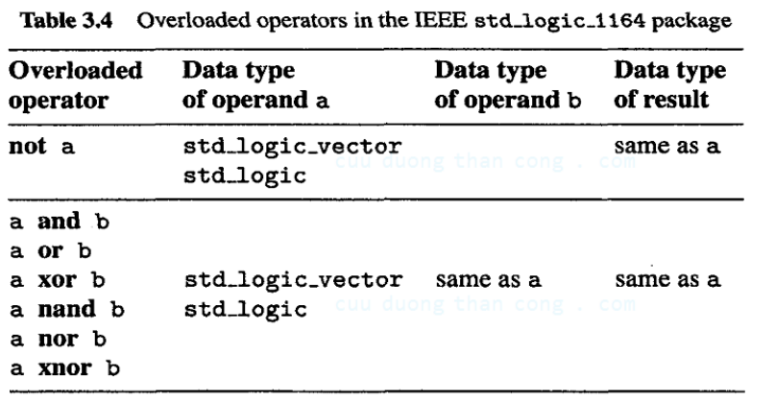
5. Data Types and Operators

Slide 31
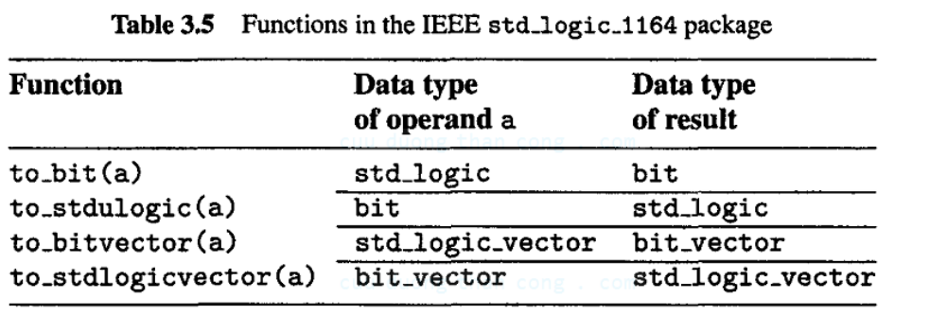
5. Data Types and Operators

Slide 32

5. Data Types and Operators
Concatenation Operator
The concatenation operator, &, is very useful for array manipulation.
We can combine segments of elements and smaller arrays to form a larger array.

Slide 33

5. Data Types and Operators
Array Aggregate
For example, if you want to assign a value of “1010_0000” to a signal “a”, it can be written as:
Another way is to list each value of the element in the corresponding position, which is known as positional association.
The previous assignment becomes

Slide 34
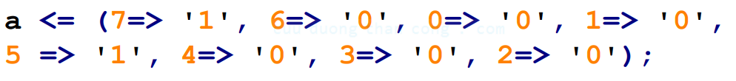

5. Data Types and Operators
Array Aggregate
We can also use the form of index => value to explicitly specify the value for each index, known as named association.
This statement can be written as
We can combine the index, as in
Or use as reserved word, others, to cover all the unused indexes, as in

Slide 35


5. Data Types and Operators
Array Aggregate
For example, if we want to assign “0000_0000” to the ‘a’ signal, we can write
It is more compact than

Slide 36
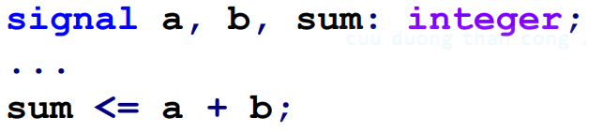
5. Data Types and Operators
To perform addition of a and b signals, we must use the integer data type, as in
It is difficult to realize this statement in hardware since the code doesn’t indicate the range (number of bits) of the a and b signals.
Although this does not matter for simulation, it is important for synthesis since there is a huge difference between the hardware complexity of an 8-bit adder and that of a 32-bit adder.

Slide 37
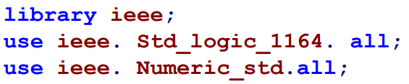
5. Data Types and Operators
A better alternative is to use an array of 0’s and 1’s and interpret it as an unsigned or signed number.
The IEEE numberic_std package was developed for this purpose.
Since the signed and unsigned data types are arrays, their declaration are similar to that of std_logic_vector data type, as in
To use the signed and unsigned data types, we must include the library statement before the entity declaration.

Slide 38
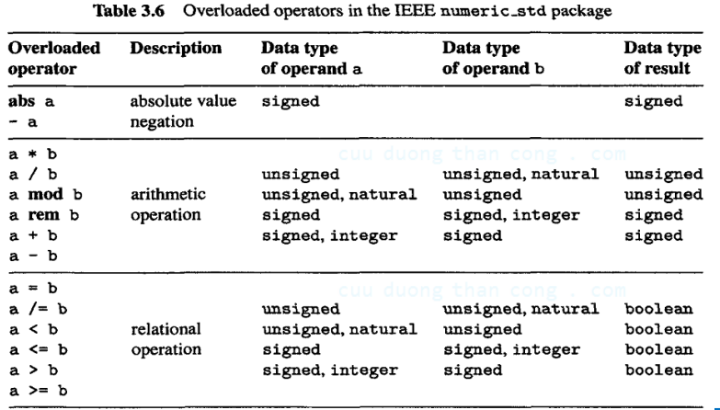
5. Data Types and Operators

Slide 39
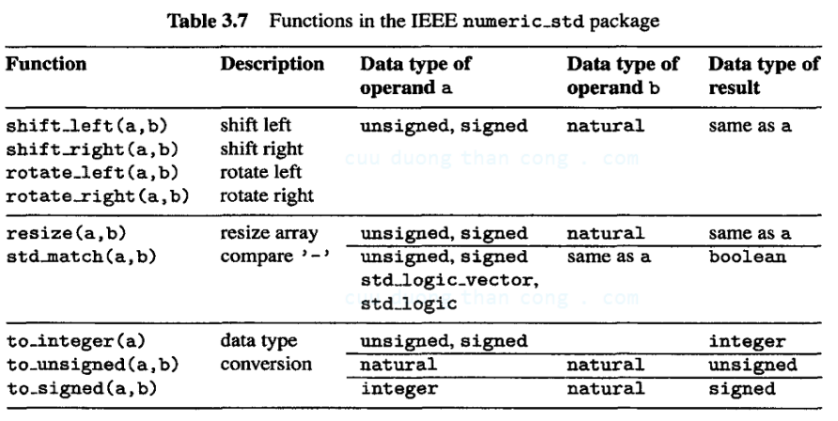
5. Data Types and Operators

Slide 40
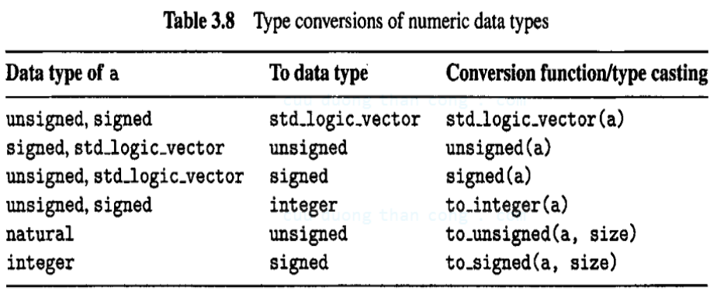
5. Data Types and Operators

Slide 41
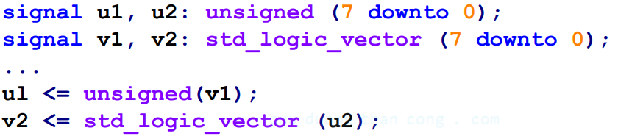
5. Data Types and Operators

Slide 42
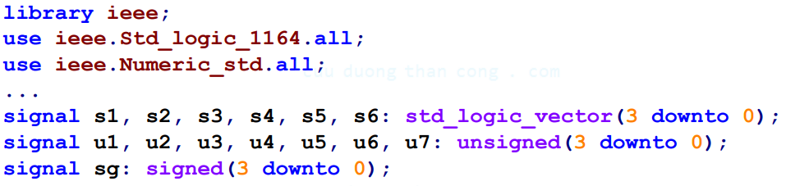
5. Data Types and Operators
Assume that some signals are declared as follows

Slide 43
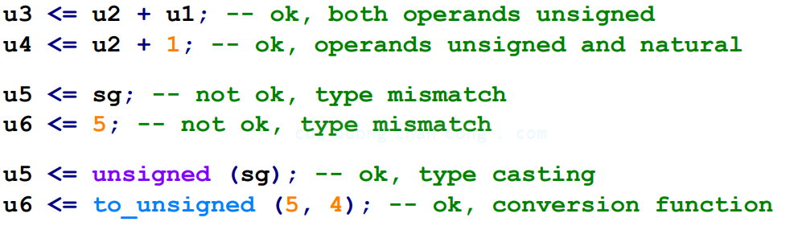
5. Data Types and Operators

Slide 44
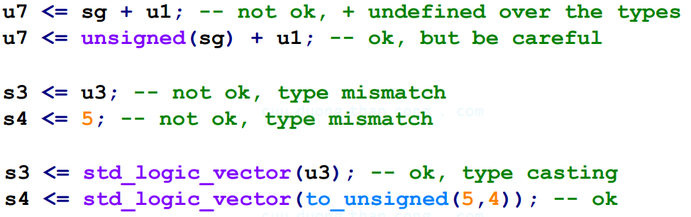
5. Data Types and Operators

